Slide 1
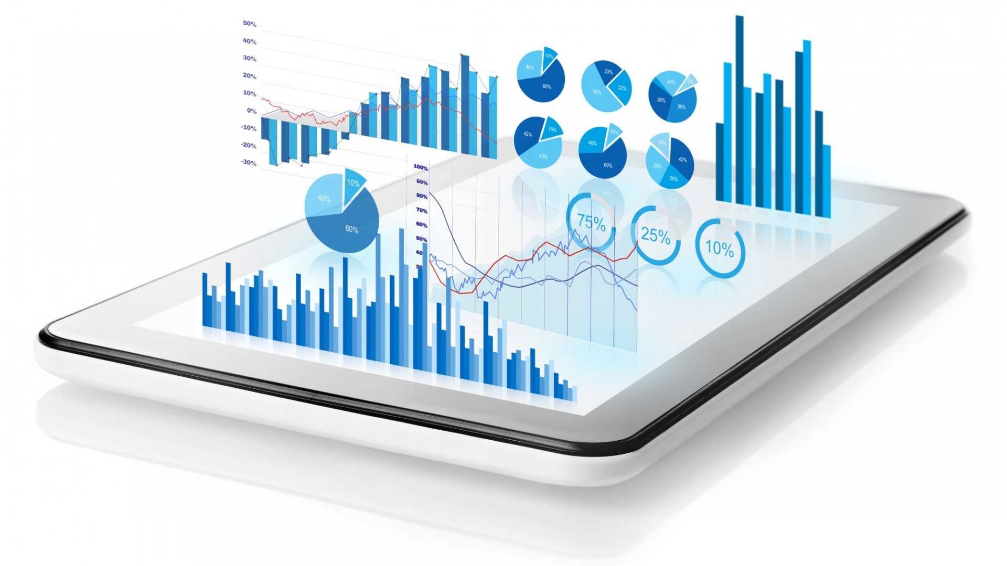
Data Visualization By rudraraju hemabindu

Slide 2
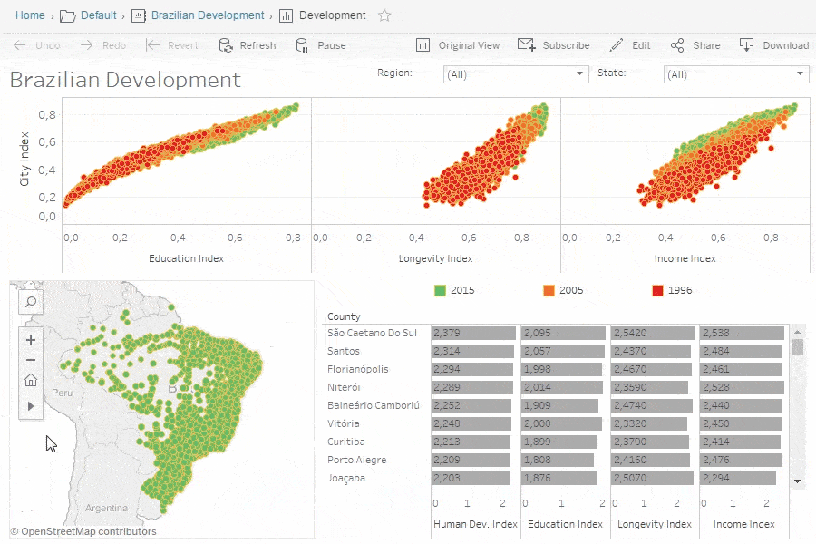
Data Visualization
What is Data Visualization?
Data visualization is the graphical representation
of information and data. By using visual elements
like charts, graphs, and maps, data visualization tools
Why data Visualization used ?
Makes Data more understandable

Slide 3




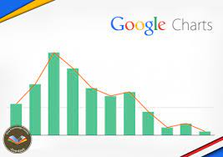
Data visualization tools
Wat are Data visualization tools
A data visualization tool is a form of software that’s designed to visualize data.
Data visualization tools :
Microsoft Excel
Power BI
Google Charts
Tableau
Zoho Analytics….etc

Slide 4
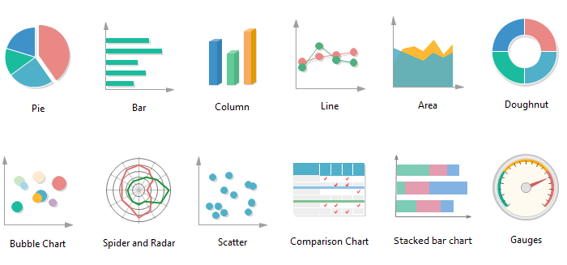
Different types of charts
Pie charts
Bar charts
Histograms
Gantt charts
Heat maps
Box-and-whisker plots
Waterfall charts
Area charts
Scatter plots
Infographics
Maps

Slide 5
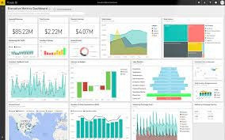
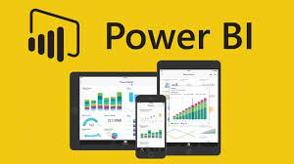
Power BI tool
It is the Data visualization tool which Connect to and visualise any data using the unified, scalable platform for self-service and enterprise business intelligence (BI) that’s easy to use and helps you gain deeper data insight.

Slide 6
Thankyou

